Slide 1
An Empire of Client States
Clients, Organizational Form, Surveillance and Empire

Slide 2
Clientalism
At least as far back as ancient Rome, powerful political units have acted through a network of clients.
The advantages of having clients rather than, say, imperial provinces are twofold:
the administrative and political costs of administering clients are considerably less than those occasioned by direct rule
have clients (referred to by the Romans as “friends”) is significantly more flattering to one’s self-image as a free political unit than to have subjects.
BUT
Counterbalancing these benefits, of course, is an obvious disadvantage: clients, by virtue of their formal independence, are often obstreperous and able to manipulate the patron for their own ends.
But Client state networks also require considerable resources to maintain.

Slide 3
Clientalism continued
Patron-client relations -- hierarchical
Often but not necessarily mutually beneficial
Commitments mostly one way -- by US

Slide 4
Organizational Form of US Clientalism
Headquarters - Washington
2 The Field – Embassies etc
Information Flows -- Communication
4 Country specific focus
5 Problems almost exclusively within Clients
Problem filtering (highlighting the situation as problems so they are addressed)
exception monitoring (responding with relevant information when policy is not working)
infinite focusing (focusing on the success or failure of current policy and WHY)
And Surveillance -- programmatic reporting of the performance of the regime and the provision of direct advise on how to perform -- The Uruguay Example

Slide 5
Organizational form continued
US officials focus on the survival and performance of the Regime of the client
Regime is the political and economic arrangements that give formal and informal power to certain types of actors (regime types vary substantially)
Clients acquiesce to be surveilled

Slide 6
Definition of as US Client
What these states all have in common is that the maintenance of their type of regime (though not by any means the individual leaders or political groupings comprising any given regime) is a) considered by the U.S. government as a legitimate matter of concern, which b) is worth considerable political and, if need be, economic and military efforts, should it be seen as endangered. In addition, the dominant political forces in each of these states also c) consider that characteristics a) and b) are themselves normal and legitimate. This, then, is a more complete definition of client states.

Slide 7
criteria for determining which states are currently U.S. clients –Footnote 56
First, we assumed, unless there was strong evidence to the contrary (e.g., the case of Cuba), that all states with whom the U.S. concluded a bilateral or multilateral mutual defense treaty before the end of the cold war are U.S. clients.
Second, we added to that list those countries with whom the U.S. has close military-to-military ties, principally via treaty arrangements permitting extensive arms transfers and military training; as well as those states over whom the U.S. at some point established detailed budgetary monitoring and control.
Other countries, notably those in which there are U.S. military bases, or with whom the U.S. recently concluded a mutual defense treaty, or for which there is evidence of CIA budgetary support or emergency military assistance, or which are in the same region as other U.S. clients, we added to the list if a) there was verbal evidence (e.g., from the State Department budget “justification” to Congress – U.S. Department of State 2005b) that the state in question is considered as an ally or otherwise important to U.S. security or b) there is no countervailing evidence of U.S. deferral to other states (e.g., France; Russia).
Finally, states that at some point had been U.S. colonies, territories, or trusteeships, or were occupied militarily by the U.S., were also included if they did not fall into any of the above categories.

Slide 8
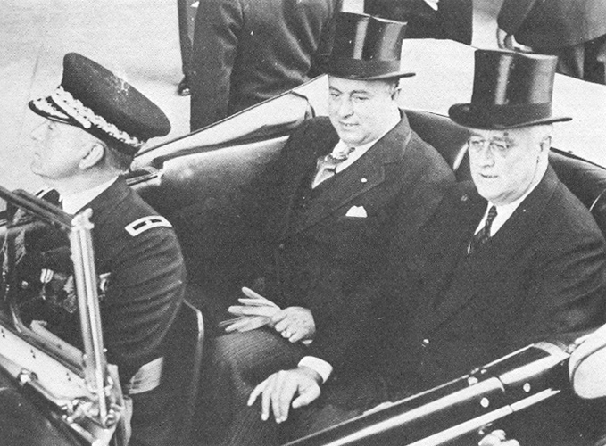
President Franklin Roosevelt with Nicaraguan dictator Anastasio Somoza in Washington, D.C.

Slide 9
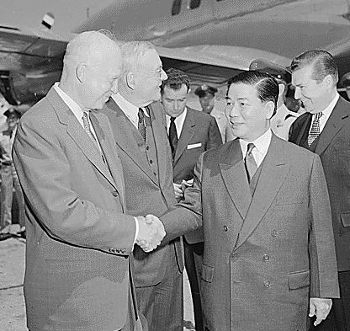
President Eisenhower greets Vietnamese President Diem

Slide 10
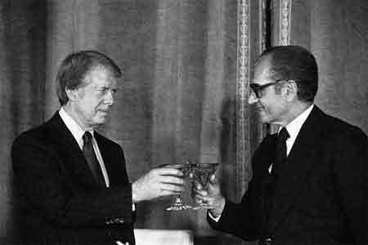
President Carter Greets the Shah of Iran

Slide 11
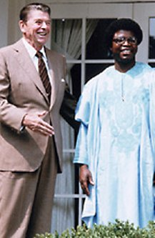
President Reagan meets Liberian President Samuel Doe

Slide 12
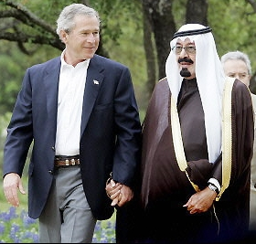
President Bush walks with Saudi King Abdullah

Slide 13
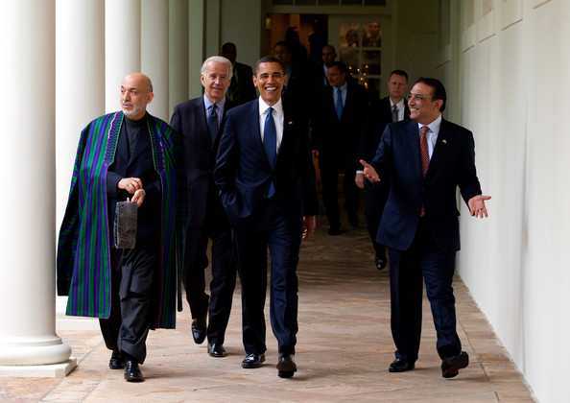
Afghan President Karzai, Vice-President Biden, President Obama and Pakistan President Zardari walk along at the White House

Slide 14
Current US Clients
Ethiopia
Ghana
Liberia
Antigua and Barbuda
Argentina
Bahamas
Barbados
Belize
Bolivia
Brazil
Canada
Chile
Colombia
Costa Rica
Dominica
Dominican Republic
Ecuador
El Salvador
Guyana
Haiti
Honduras
Jamaica
Mexico
Nicaragua
Panama
Paraguay
Peru
Saint Kitts and Nevis
Saint Lucia
Saint Vincent/Grenadines
Suriname
Trinidad and Tobago
Uruguay
Grenada
Guatemala
Venezuela

Slide 15
Current US Clients
Austria
Bosnia and Herzegovina
Belgium
Denmark
France
Germany
Greece
Iceland
Italy
Luxembourg
Macedonia
Netherlands
Norway
Poland
Portugal
Spain
Sweden
Turkey
United Kingdom
Bahrain
Egypt
Iraq
Israel
Jordan
Kuwait
Oman
Qatar
Saudi Arabia
Tunisia
United Arab Emirates
Afghanistan
Pakistan
Australia
Indonesia
Japan
Malaysia

Slide 16
Current US Clients
Marshall Islands
Micronesia
New Zealand
Palau
Philippines
Singapore
South Korea
Taiwan
Thailand
Total Countries Worldwide/Percent Worldwide
Clients 81 – 42.6%
Non-Clients 109 – 57.4%
Total Population Worldwide/Percent Worldwide
Clients 2,070,997,673 – 34.7%
Non-Clients 3,893,665,267 – 65.3%
Total GDP (in millions US $) Worldwide/Percent Worldwide
Clients 20,940,793 – 82.2%
Non-Clients 4,535,441 – 17.8%

Slide 17
Client Acquisition in chronological order
Hawaii, 1893-1898
Cuba, 1902-1959
Panama, 1903-present
Dominican Republic, 1905-present
Nicaragua, 1910-1981
Honduras, 1911-present
Haiti, 1915-present
Costa Rica, 1919-present
Guatemala, 1920-present
El Salvador, 1922-present
Mexico, 1940-present
Colombia, 1940-present
Venezuela, 1940-present
Bolivia, 1940-present
Ecuador, 1940-present
Peru, 1940-present
Chile, 1940-present
Paraguay, 1940-present
Uruguay, 1940-present
Brazil, 1940-present
Canada, 1941-present
Liberia, 1942-present
China, 1943-1949
Italy, 1945-present
Philippines, 1946-present
Argentina, 1946-present
Greece, 1947-present
Turkey, 1947-present
France, 1948-present
UK, 1948-present
Belgium, 1948-present
Netherlands, 1948-present
Luxembourg, 1948-present
Denmark, 1948-present
Norway, 1948-present
Iceland, 1948-present

Slide 18
Client Acquisition in chronological order - continued
Portugal, 1948-present
Sweden, 1948present
Israel, 1948-present
South Korea, 1948-present
West Germany, 1949-present
Thailand, 1950-present
Taiwan, 1950-present
Australia, 1951-present
New Zealand, 1951-present
Japan, 1951-present
Spain, 1953-present
Saudi Arabia, 1953-present
Iran (ex-Mossadeq), 1953-1979
Pakistan, 1954-present
South Vietnam, 1955-1975
Austria, 1955-present
Lebanon, 1957-1984
Ethiopia, 1959-1977
Jamaica, 1963-present
Trinidad and Tobago, 1963-present
Congo (Zaire), 1963-1997
Laos, 1964-1975
Jordan, 1965-present
Ghana, 1966-present
Indonesia, 1966-present
Guyana, 1966-present
Tunisia, 1967-present
Cambodia, 1970-1975
Malaysia, 1977-present
Singapore, 1977-present
Egypt, 1978-present
Barbados, 1980-present
Saint Lucia, 1981-present
Saint Vincent and the Grenadines, 1981-present
Dominica, 1981-present

Slide 19
Client Acquisition in chronological order - continued
Antigua and Barbuda, 1981-present
Belize, 1982-present
St. Kitts and Nevis, 1984-present
Grenada, 1984-present
Bahamas, 1985-present
Marshall Islands, 1986-present
Micronesia, 1986-present
Nicaragua, 1990-present
Suriname, 1991-present
Ethiopia, 1991-present
Kuwait, 1991-present
Bahrain, 1991-present
Oman, 1991-present
United Arab Emirates, 1991-present
Qatar, 1991-present
Palau, 1994-present
Bosnia, 1996-present
Macedonia, 1996-present
Poland, 1998-present
Afghanistan, 2001-present
Iraq, 2004-present

